Slide 1

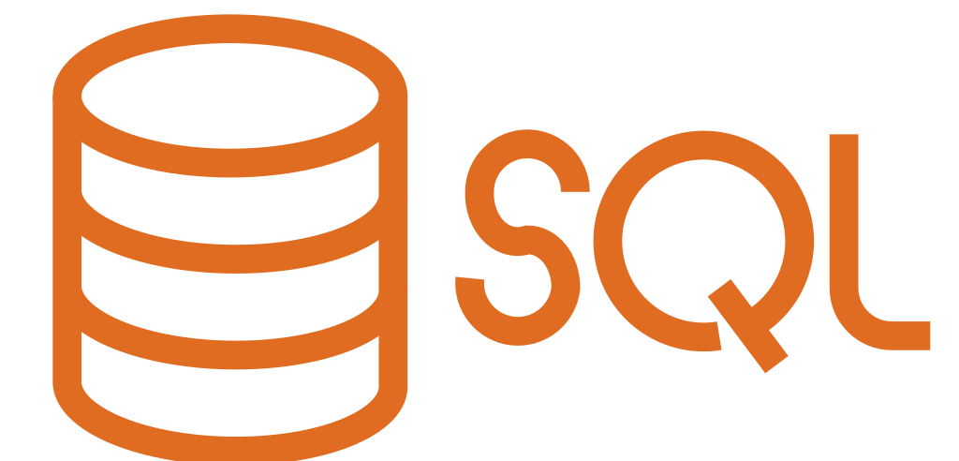
MongoDB vs SQL

Slide 2

Introduction
Introduction to SQL and NoSQL
SQL Databases
Structured Query Language (SQL) for managing data.
Relational databases organized in tables with rows and columns.
Examples: MySQL, PostgreSQL, Oracle DB.
MongoDB (NoSQL)
NoSQL (Not Only SQL) database, schema-less.
Stores data in JSON-like documents (BSON format).
Ideal for unstructured or semi-structured data.

Slide 3
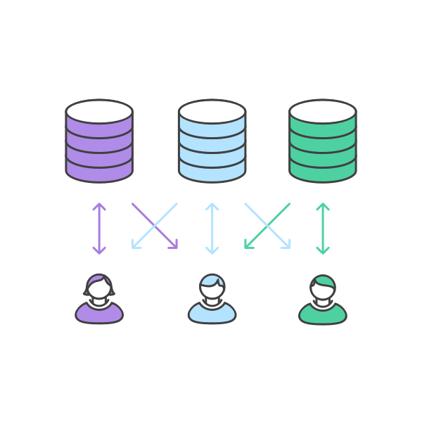
SQL Databases: Core Features
Data Structure: Tables with predefined schemas.
Queries: Standardized SQL syntax for CRUD operations.
ACID Compliance: Ensures reliable transactions.
Use Cases: Financial systems, ERP, inventory management.
Scaling: Vertical scaling (adding resources to a single server).

Slide 4

Core Functionalities of MongoDB
MongoDB: Core Features
Data Structure: Flexible, document-oriented (key-value pairs).
Queries: JSON-like syntax, supports dynamic queries.
CAP Theorem: Prioritizes availability and partition tolerance.
Use Cases: Big data, real-time analytics, content management.
Scaling: Horizontal scaling (adding more servers).

Slide 5
Direct Comparison
Feature | SQL Databases | MongoDB
Data Model | Relational (tables) | Document-oriented
Schema | Fixed, predefined | Dynamic and flexible
Scalability | Vertical scaling | Horizontal scaling
ACID Compliance | Full ACID transactions | Limited ACID (supports multi-document ACID since v4.0)
Performance | Slower for unstructured data | Faster for unstructured data
Query Language | SQL | JSON-like queries
Best For | Structured, complex relationships | Unstructured, evolving data models

Slide 6
Conclusion
Choosing the Right Database
SQL Databases:
Best suited for structured data, transactional systems.
Use when relationships between data are complex and well-defined.
MongoDB:
Ideal for flexible, unstructured data with rapid scalability.
Use when high performance and scalability are key requirements.
Key Takeaway:
The choice depends on the project’s data structure, scalability needs, and use cases.

Slide 7


